Slide 1
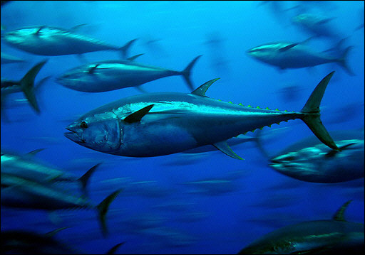





D A Kiefer, D P Harrison, M G Hinton, S Kohin, E M Armstrong, S Snyder, F J O’Brien
Pelagic Habitat Analysis Module (PHAM) for GIS Based
Fisheries Decision Support

Slide 2
Pelagic Habitat Analysis Module (PHAM)
Fisheries Catch/Survey Data
Tagging Data
Satellite Imagery
Circulation Model
EASy GIS
PHAM Tools & Statistics
visit runeasy.com
Dynamic Maps of Habitat
Data & Results of Statistical Analysis

Slide 3
Improving Fisheries Management
Stock Assessment / By-catch
Tuna of the EPO
Important Commercial Species ($2-3 B annual revenues Eastern Pacific)
Stock assessment models only provide a reliable estimate of recruitment several years after the fact
Very little (if any) environmental data used in stock assessment models
Sharks of the California Current
Stock assessment model for Thresher Sharks – Input from PHAM GAM
By-catch Management – Where does habitat overlap commercial fishing?
Distribution of pregnant females

Slide 4


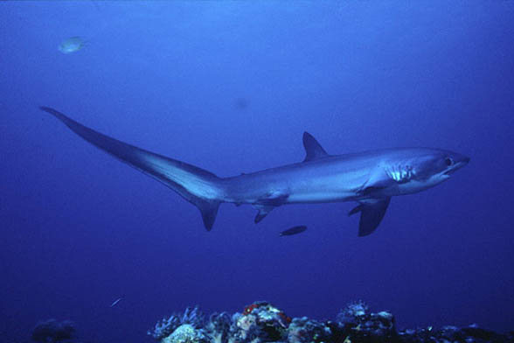
Mako Shark (Isurus oxyrhynchus)
Blue Shark (Prionace glauca),
Common Thresher Shark (Alopias vulpinus)

Slide 5
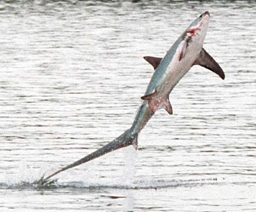
Environmental Characteristics
Fisheries Data
Survey Data
Commercial Catch Data
Vessel Logbook Data
Recreational Fishing Data
Tagging data (not yet)
Satellite Imagery
Seawifs Chl
Modis Chl
Modis SST
GHRSST
AVHRR SST
AVISO SSH
Quickscatt Winds
NOAA Coastwatch Frontal Probability
NSA JPL Frontal Probability
EPTO Bathymetry
NASA ECCO 2 Model
Mixed Layer Depth
SST
Temperature at Depth
SSH
Sea Surface Salinity
Currents
EASy Built In
Earth Magnetic Field
Longitude
Latitude
Month

Slide 6
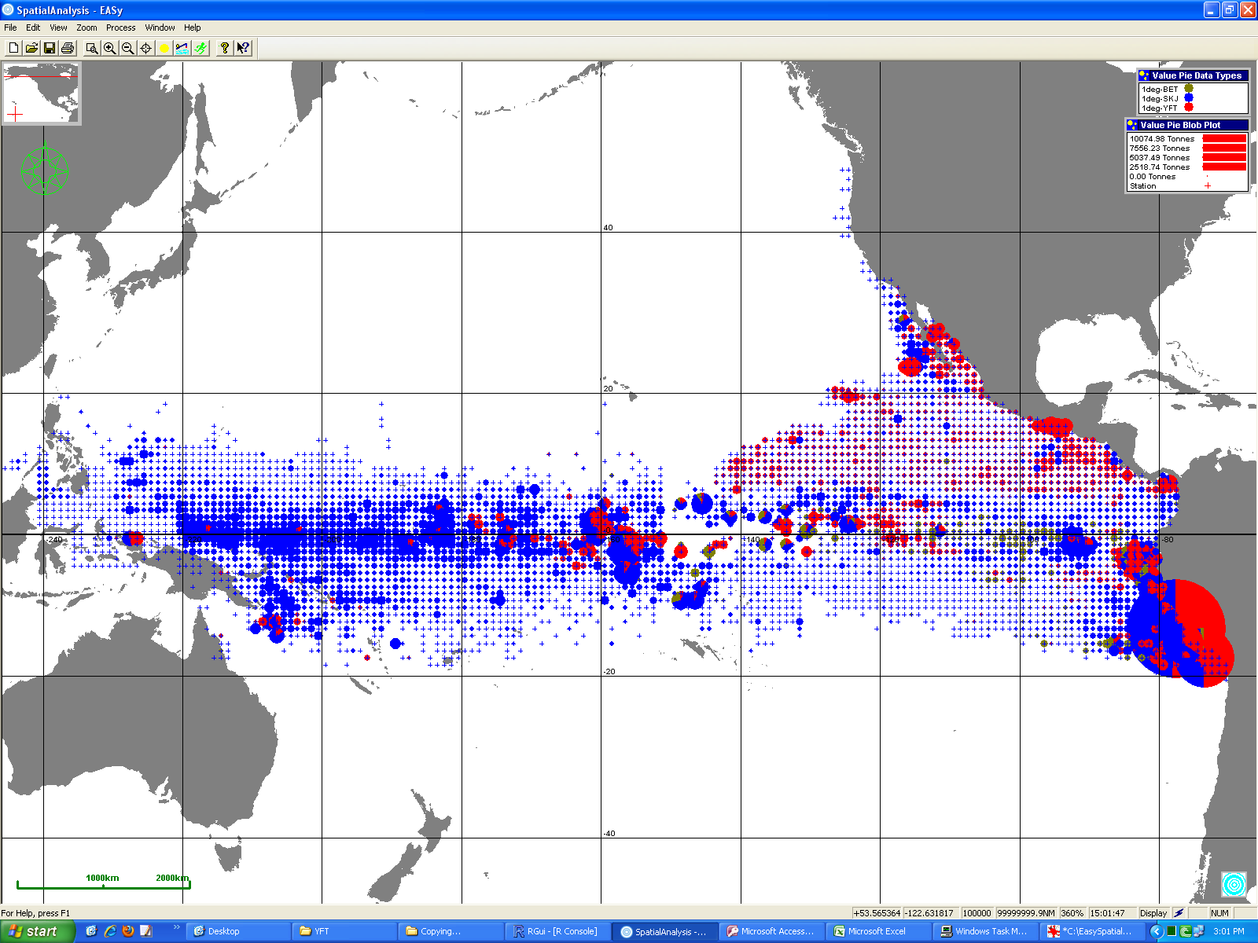
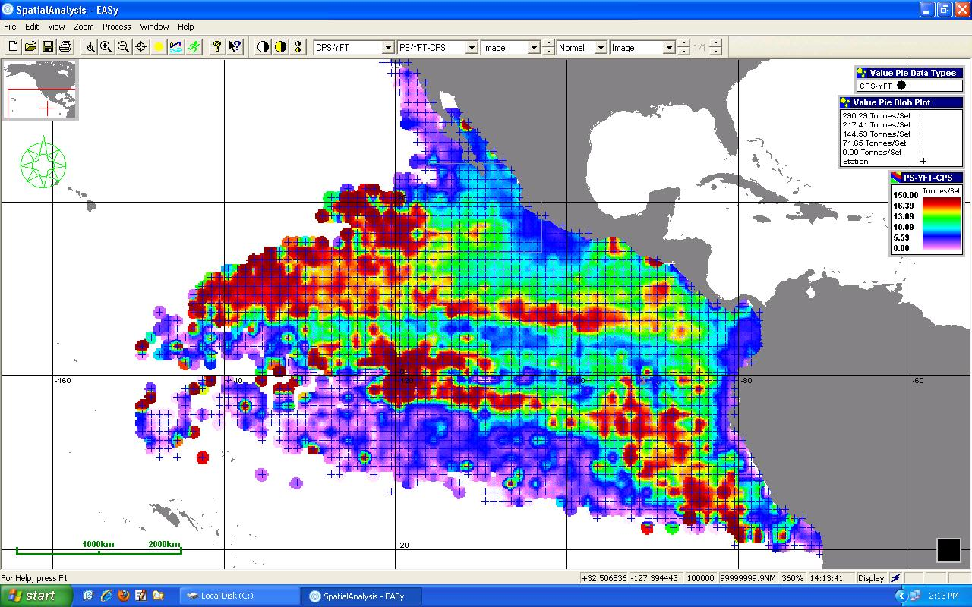
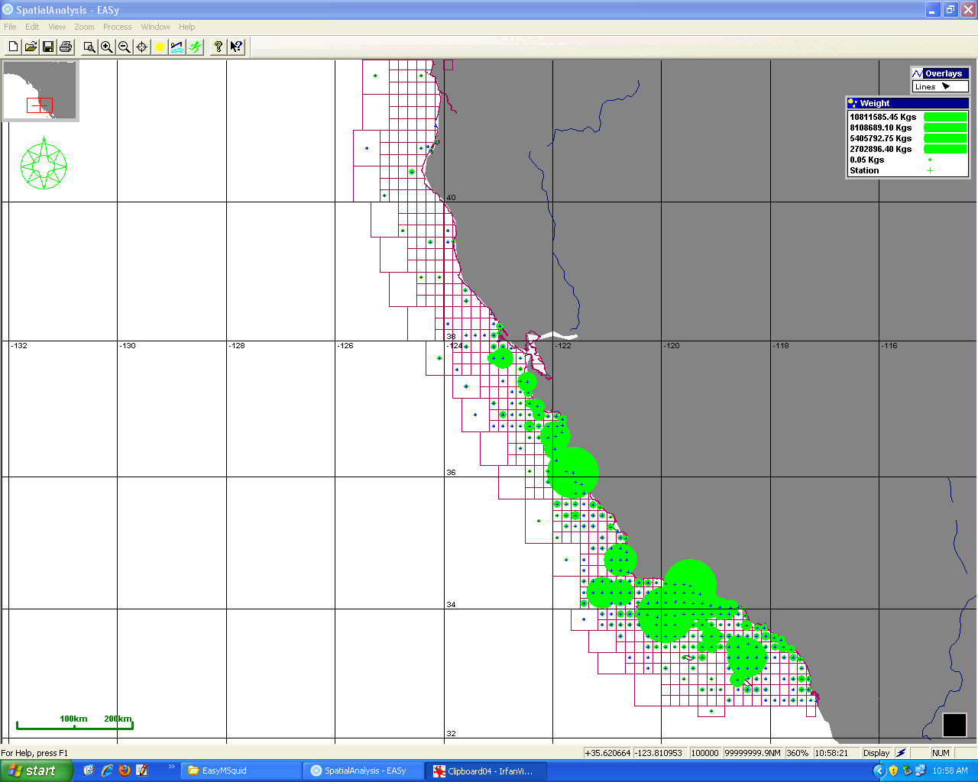
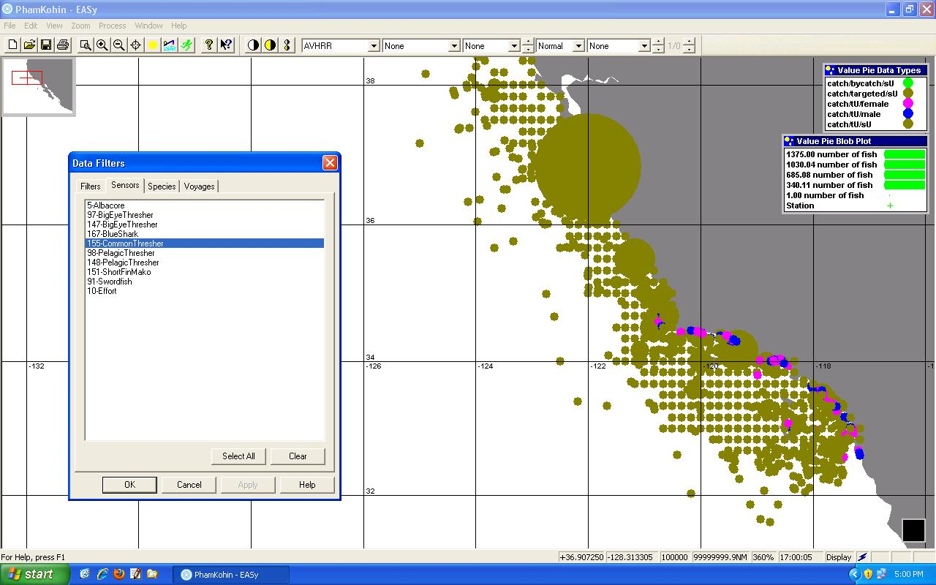
Average catch per set (Purse Seine) Tuna, IATTC 35yrs
Average catch per set (Purse Seine) for Yellowfin Tuna, IATTC 35 Yr Timeseries
Average Catch Market Squid
Average Catch Number by Sex – Common Thresher Shark, SWFSC

Slide 7
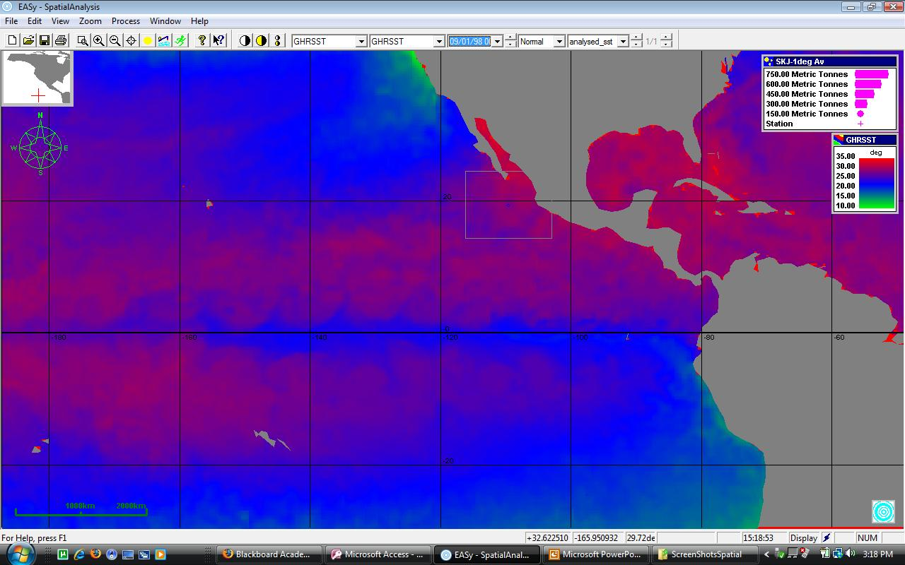
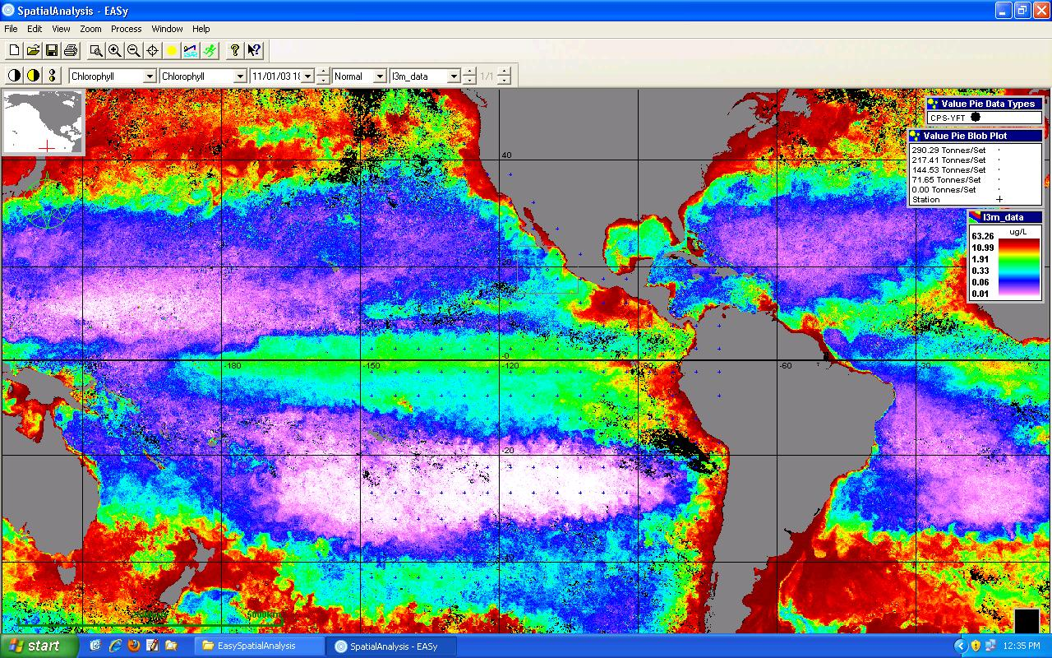
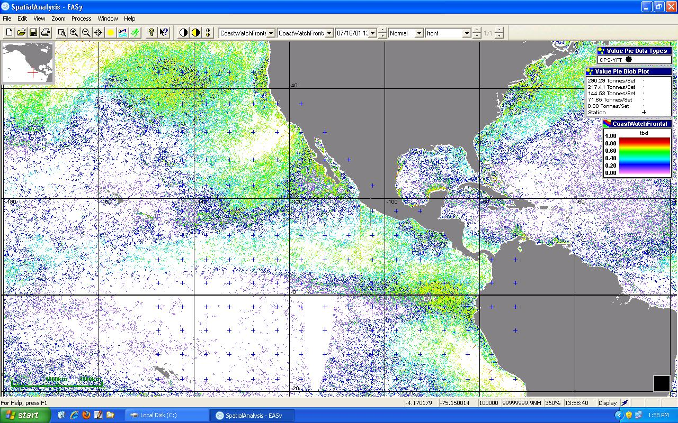
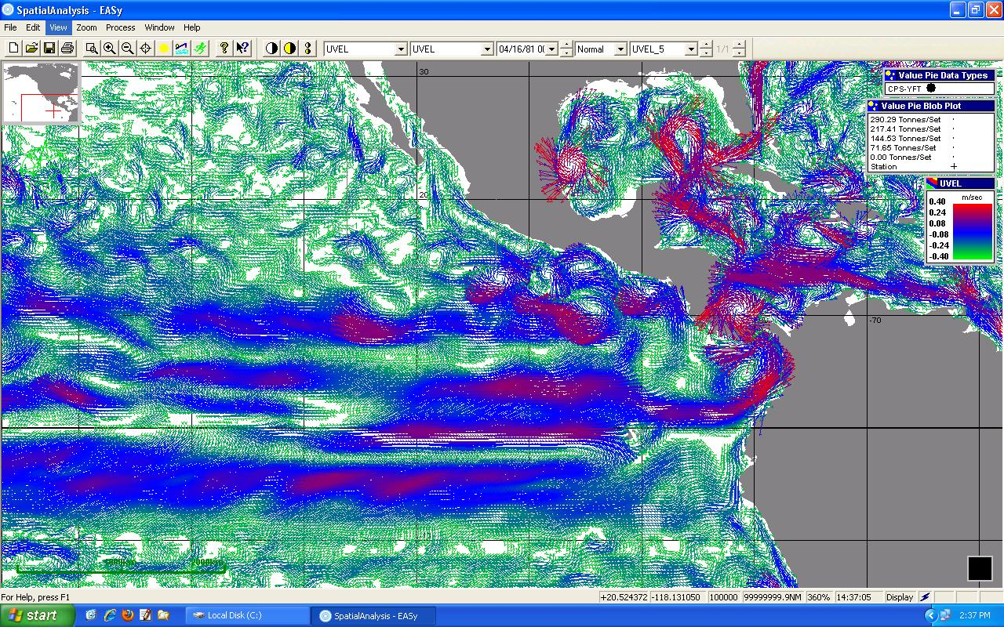
Environmental Characteristics
GHRSST Sea Surface Temperature
SeaWiFS Chlorophyll
NOAA Coastwatch Frontal Probability
NASA ECCO2 Ocean Currents

Slide 8
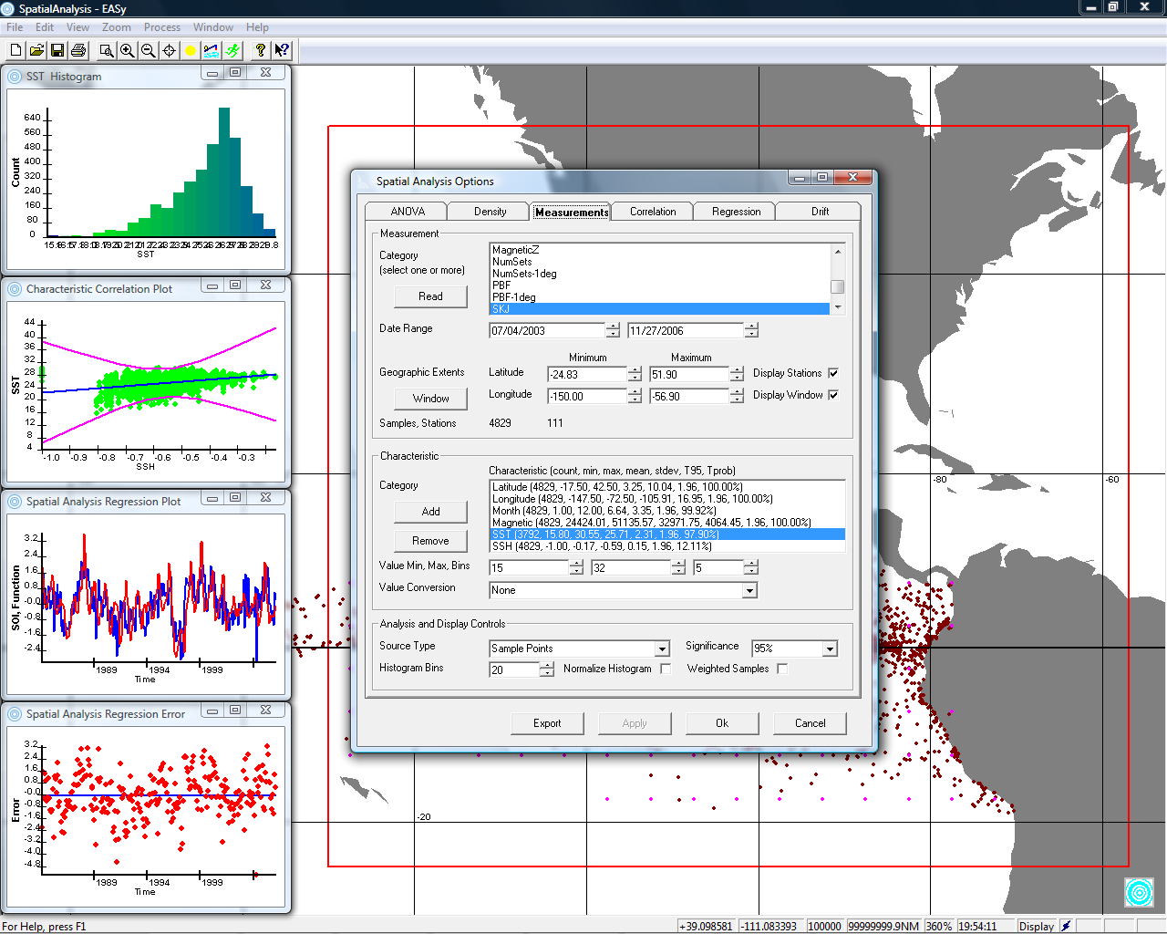
PHAM screen of habitat analysis interface, map of calculated spawning sites, and graphical results of analysis
Notes:
8

Slide 9
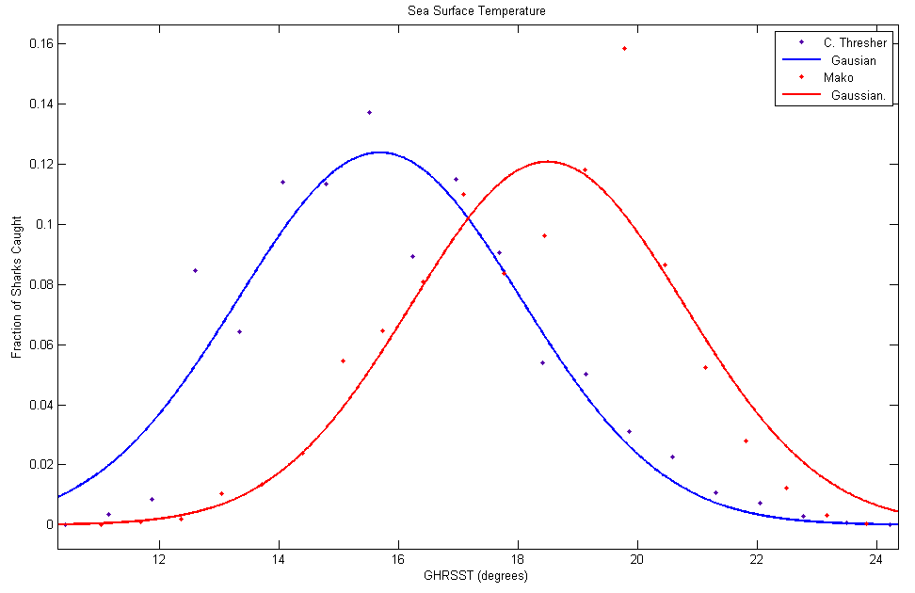
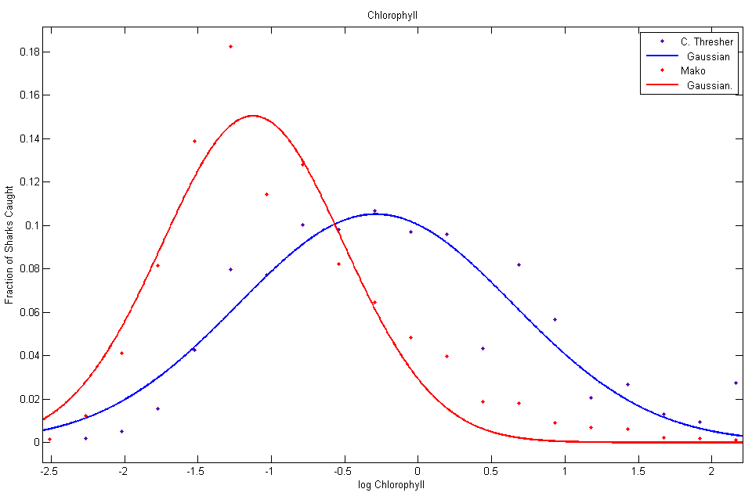
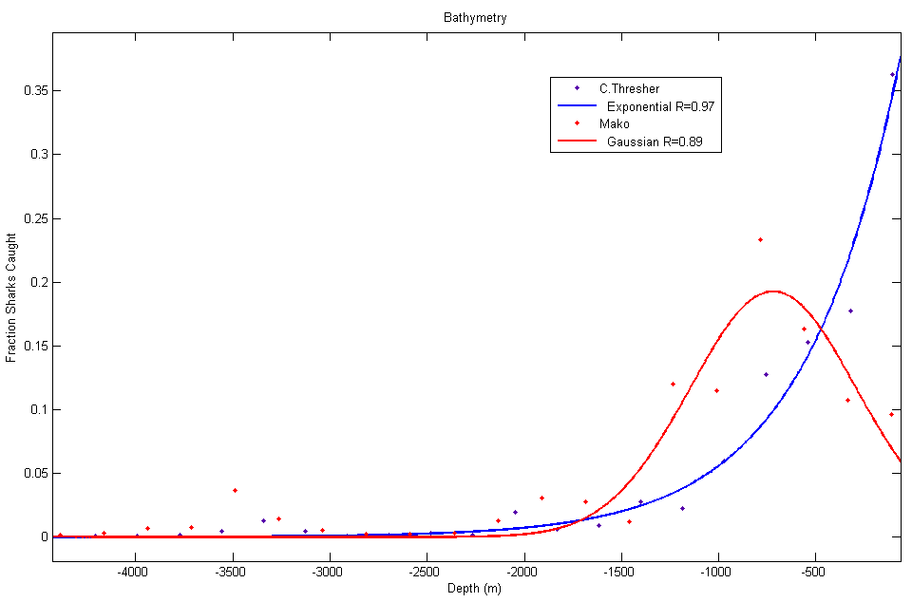
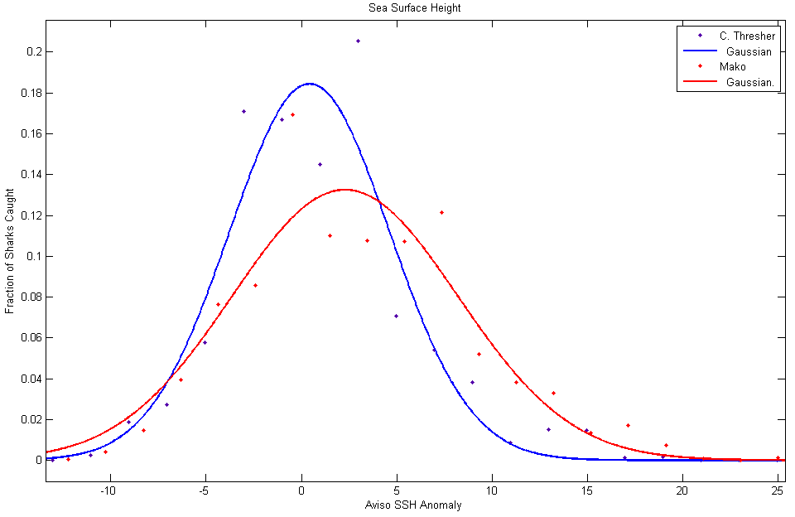
Common Thresher & Mako Shark Analysis

Slide 10
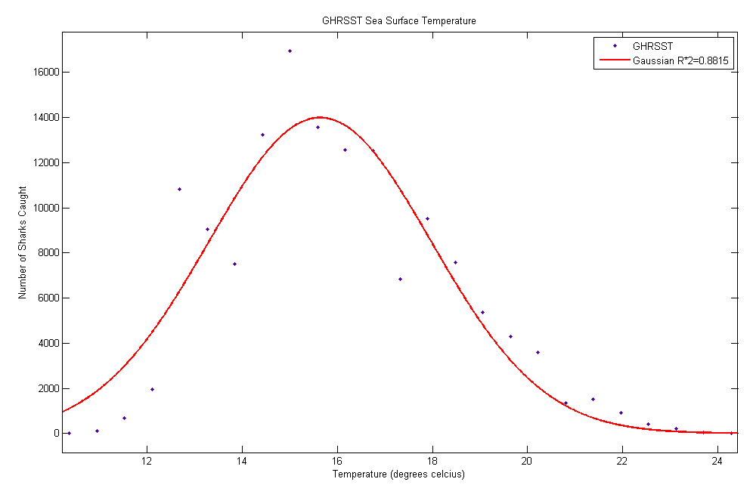
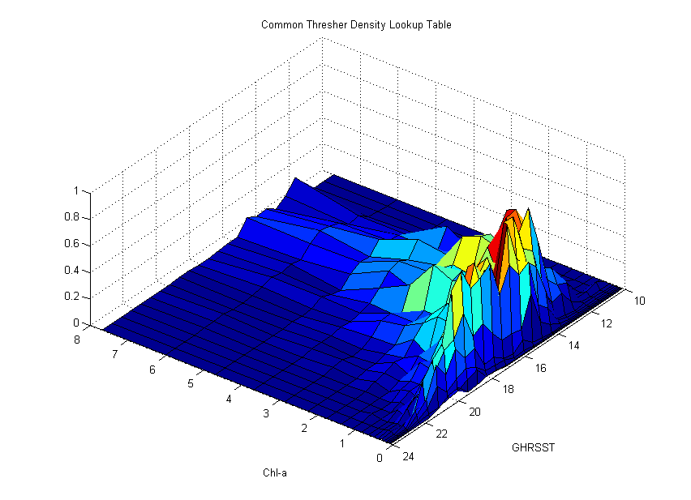
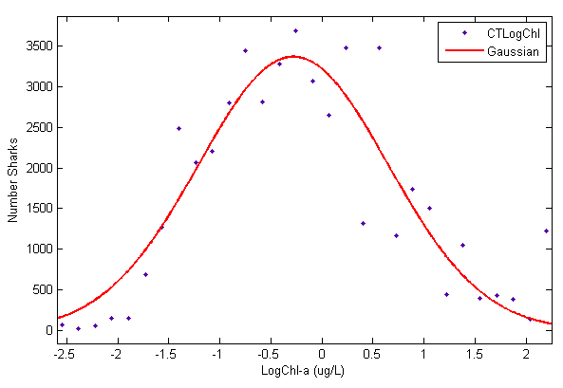
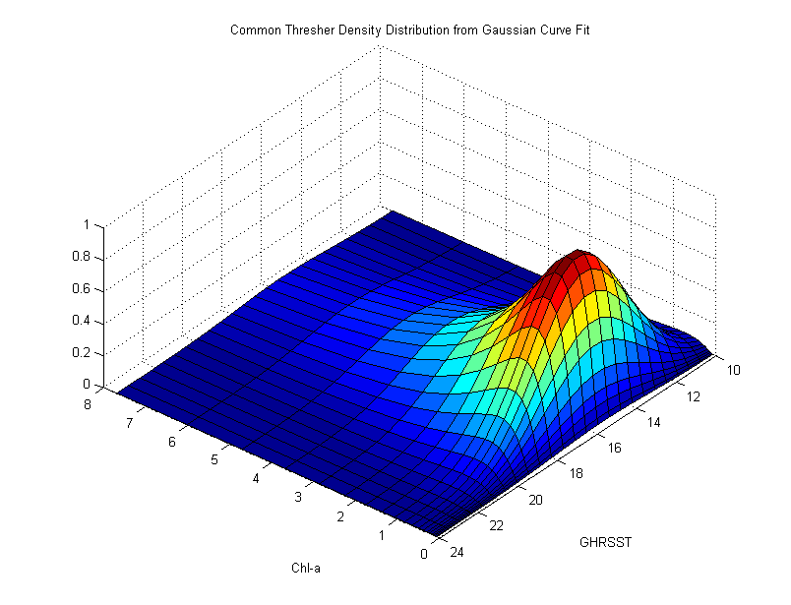
Common Thresher Shark Habitat Mapping

Slide 11
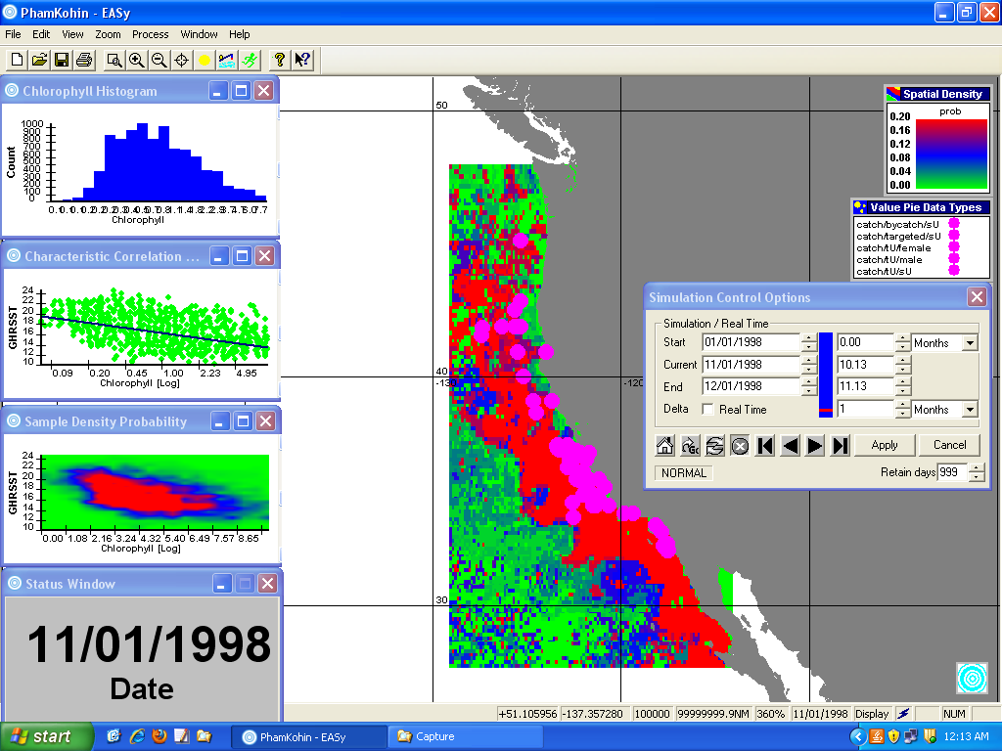

Slide 12
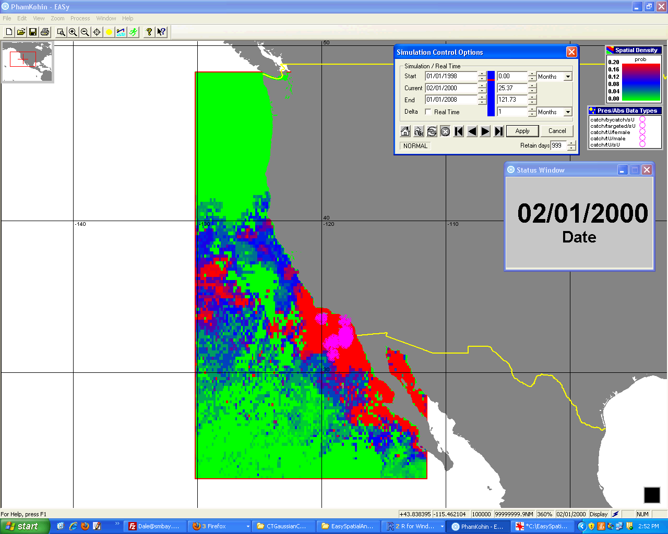
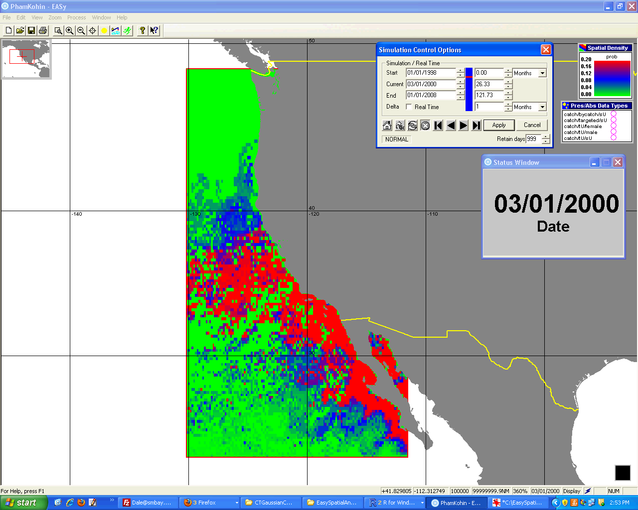
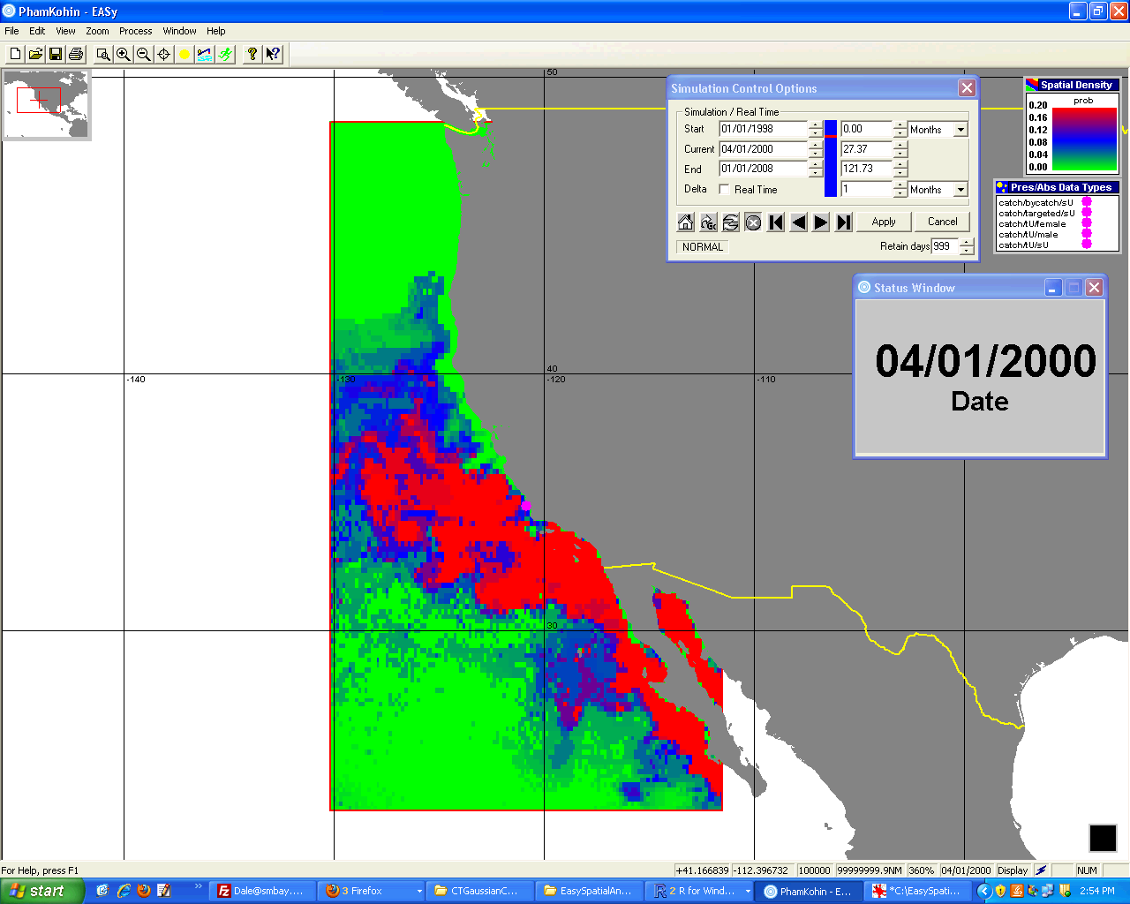
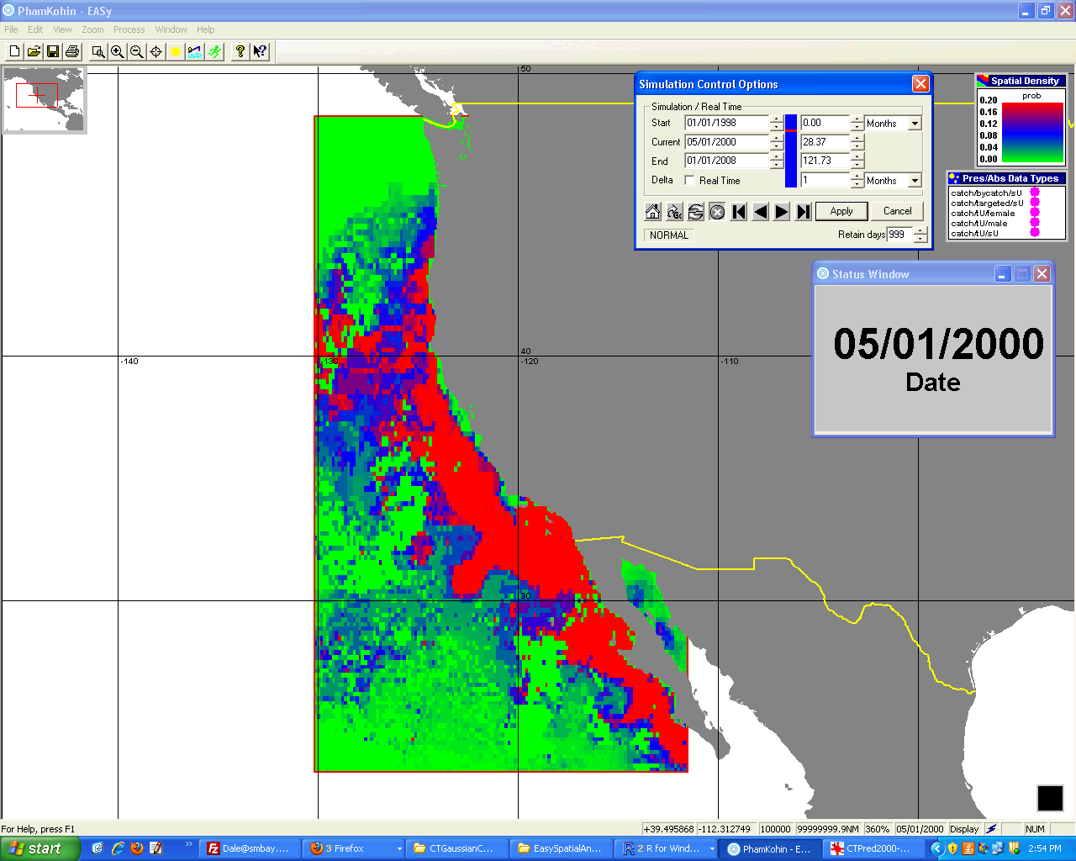
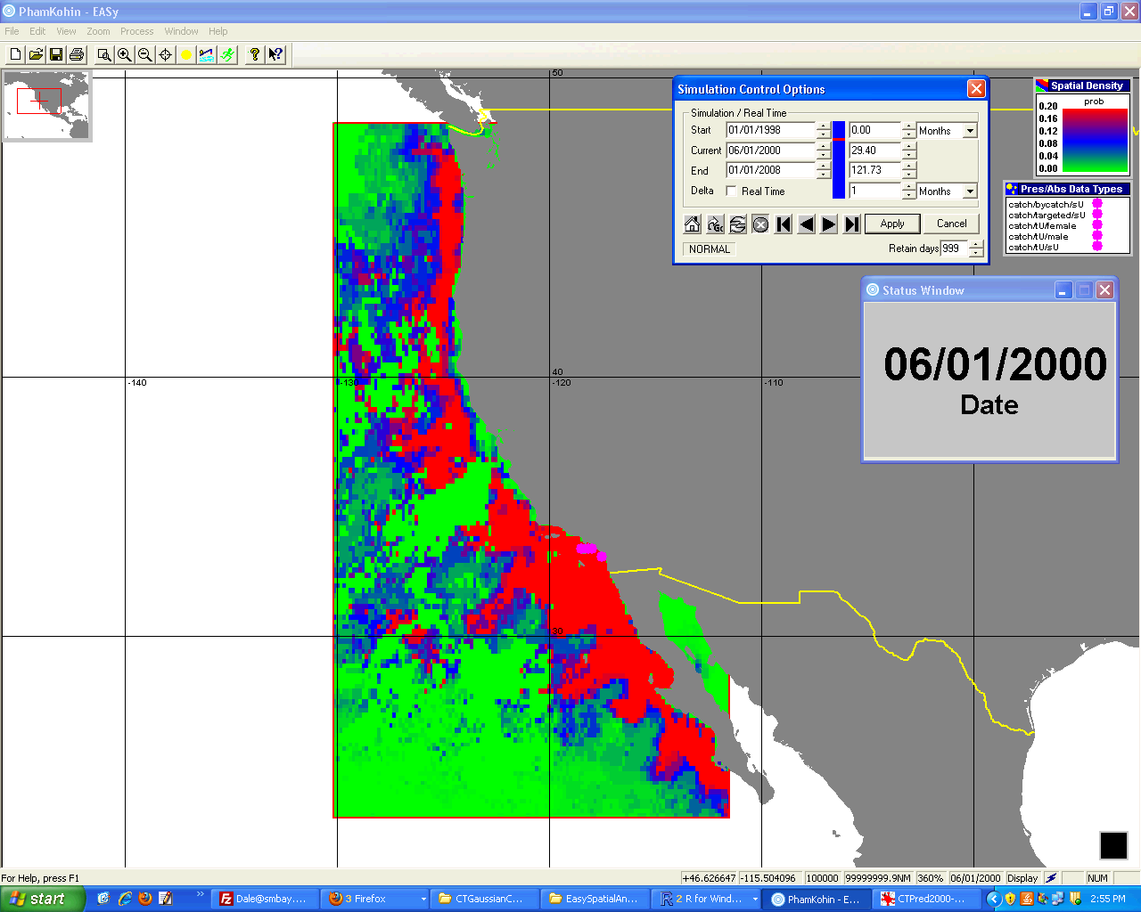
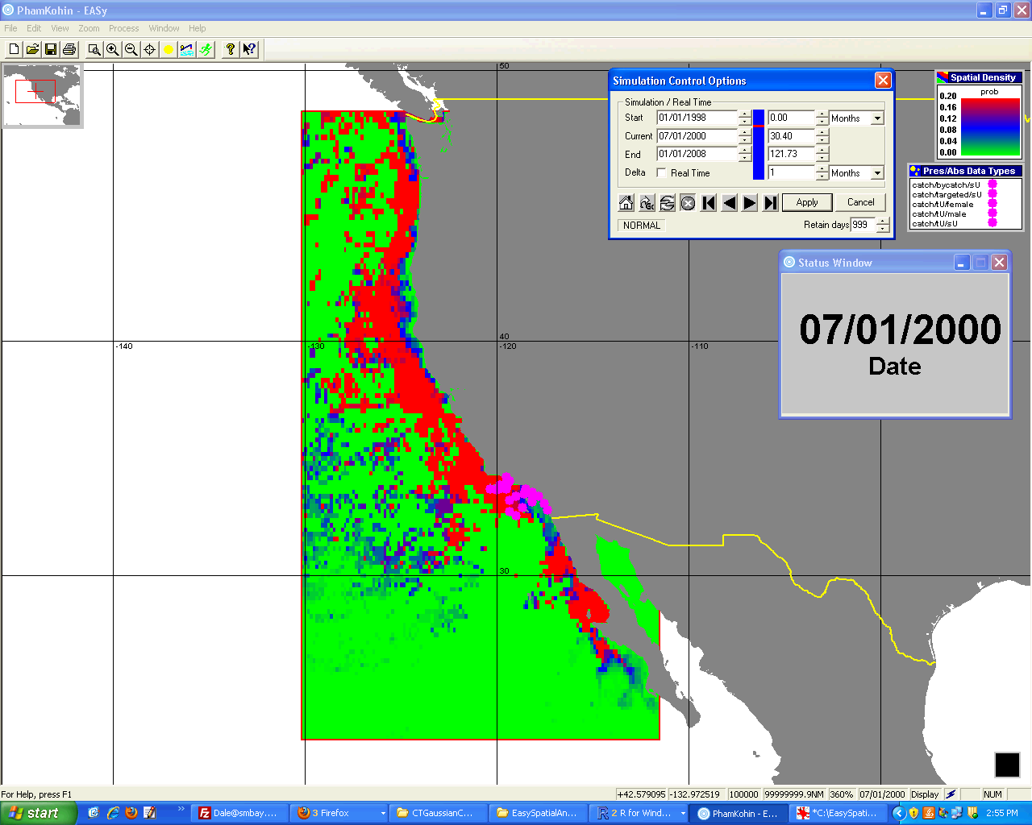
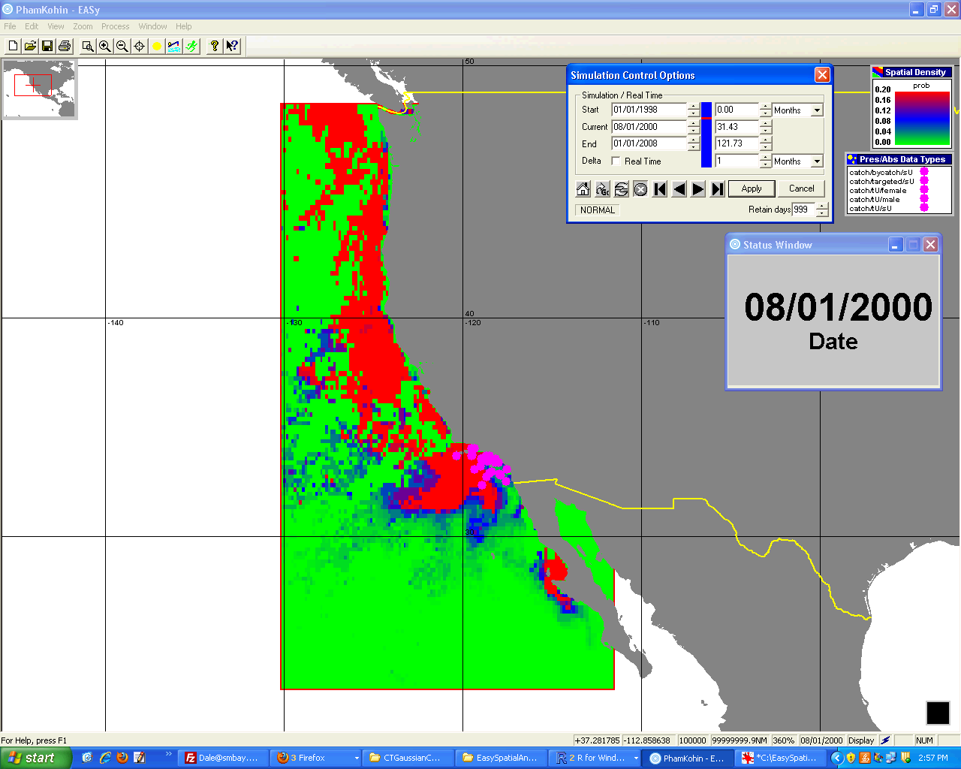
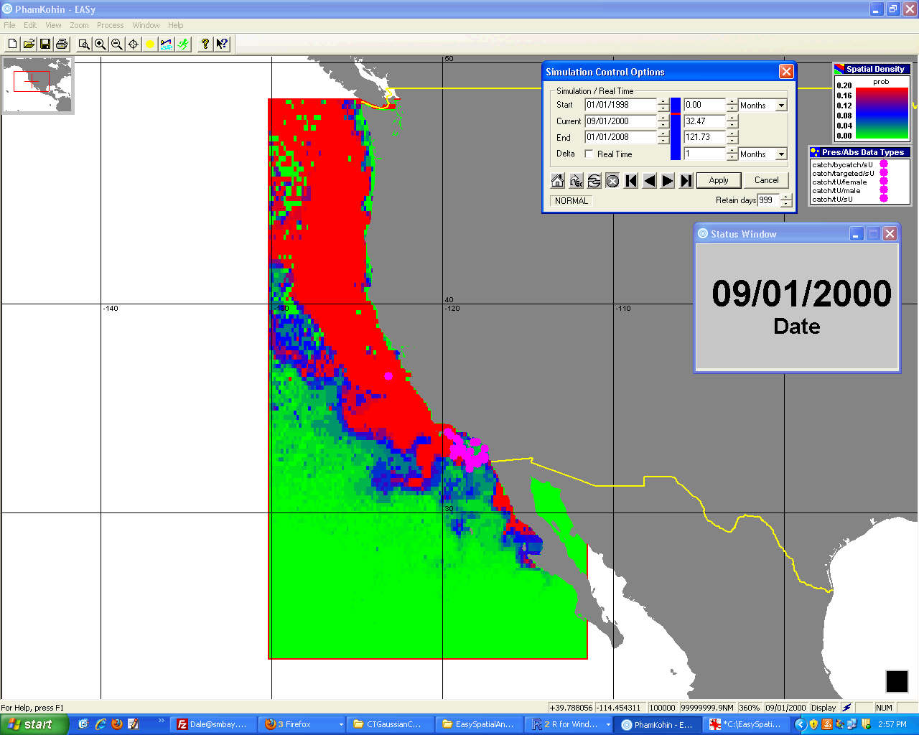
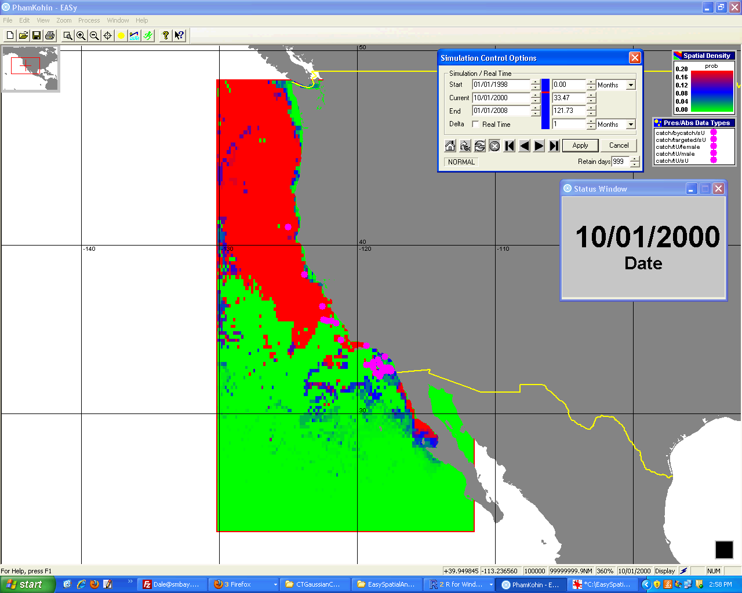
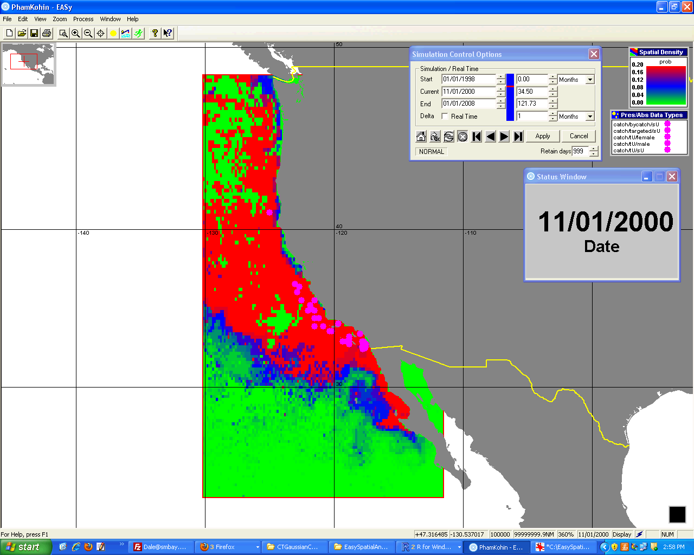
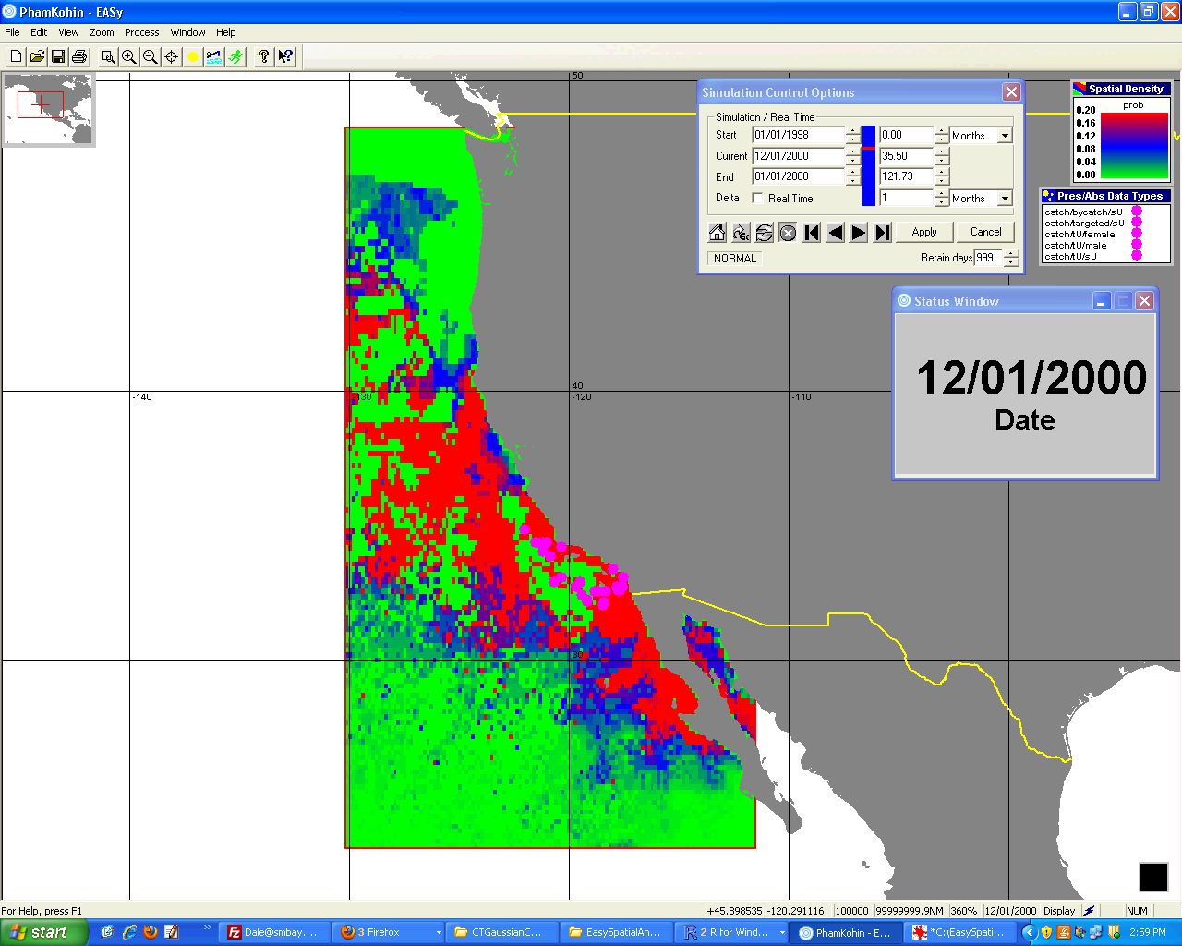
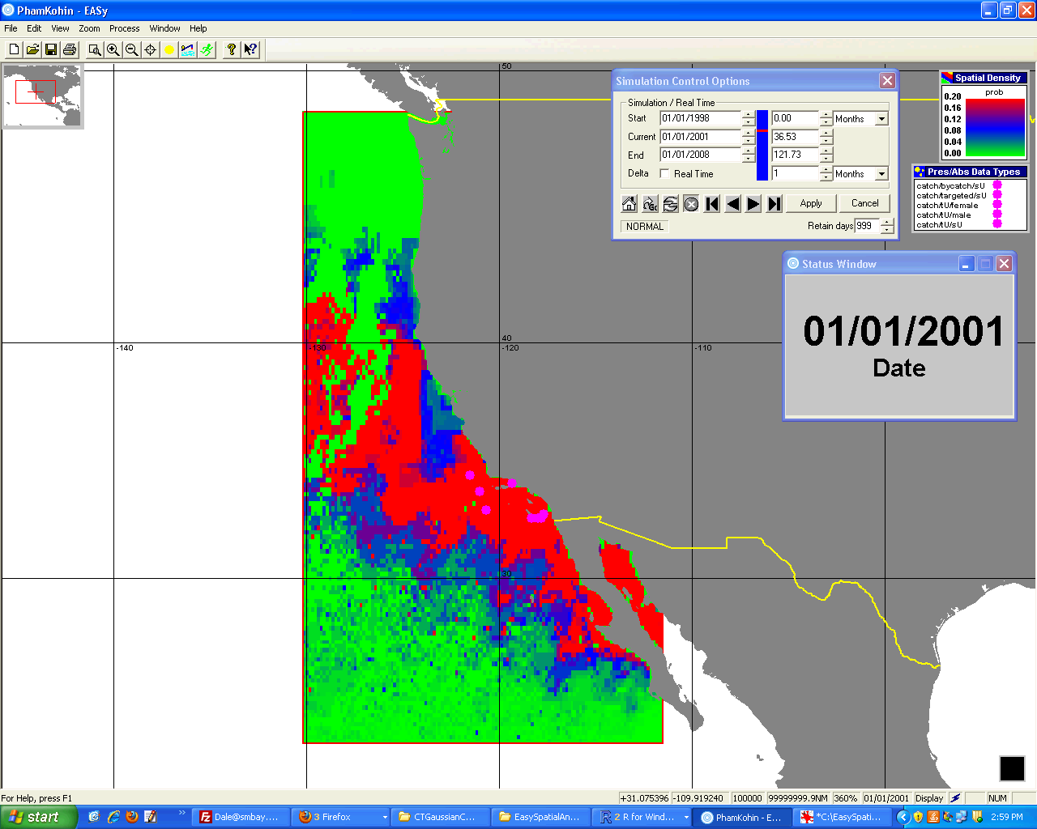
JAN
FEB
MAR
APR
MAY
JUN
JUL
AUG
SEP
OCT
NOV
DEC
PHAM Common Thresher Shark Habitat Prediction for 2000
based on chlorophyll and SST

Slide 13
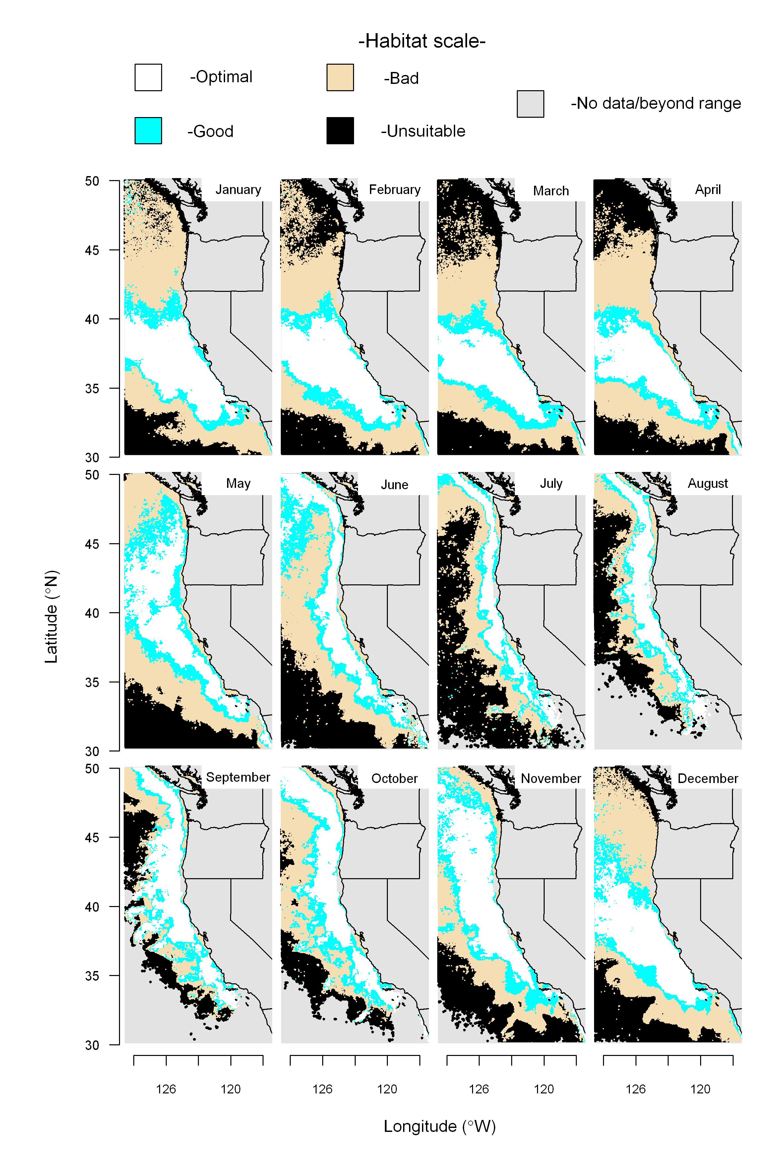
Warm Years: 1998-2009
The habitat scale is derived from a non‑linear and multidimensional combination of concurrent sea‑surface temperature, chlorophyll concentration and the gradient derived from sea‑surface height images.
The pattern described by the seasonal movement of the habitat explains the fisheries patterns of US and Canada and the migrations routes suggested in the 1940's.
Unpublished results kindly provided by
Juan P. Zwolinski, Robert L. Emmett, and David A. Demer of the Southwest Fisheries Science Center.

Slide 14
Conclusions
We have assembled a system that integrates satellite and model output with fisheries data
We have developed tools that allow analysis of the interaction between species and key environmental variables
Demonstrated the capacity to accurately map habitat of Thresher Sharks Alopias vulpinus & pelagicus. Their seasonal migration along the California Current is at least partly driven by the seasonal migration of sardine, key prey of the sharks.
If you are interested in using PHAM software (free) please contact kiefer@usc.edu.
Initial Tasks for this Year
Incorporate electronic tag tracks for Bigeye and Yellowfin tuna of the Eastern Pacific in order to define the 3 dimension of their habitat.
Apply PHAM tools to building a stock assessment model for thresher sharks that will be used by SWFSC to regulate coastal recreational and commercial fisheries.
Build interface between our EASy geographical Information System and R statistics program.

